Slide 1
Water Quality Analysis

Slide 2
Problem Statement
The Chicago Park District maintains sensors in the water at beaches along Chicago's Lake Michigan lakefront. These sensors generally capture the indicated measurements hourly while the sensors are in operation during the summer.
Various parameters are analysed

Slide 3
Tools: Python
Data Source: https://data.cityofchicago.org/Parks-Recreation/Beach-Water-Quality-Automated-Sensors/qmqz-2xku

Slide 4
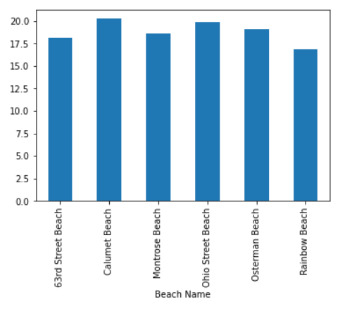
BEACH NAME VS WATER TEMPERATURE
Highest temperature recorded in calumet beach

Slide 5
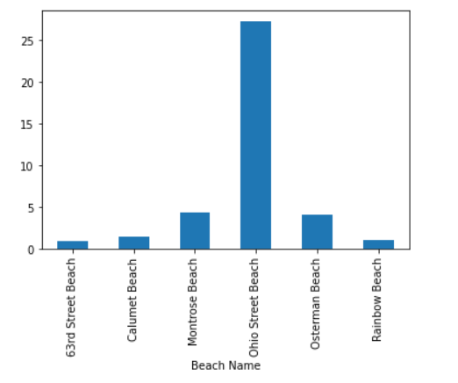
BEACH NAME VS TURBIDITY
Most turbid beach is Ohio street beach

Slide 6
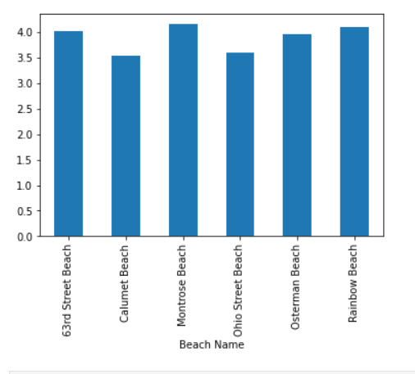
BEACH NAME VS WAVE PERIOD
Highest wave period is seen in Montrose Beach

Slide 7
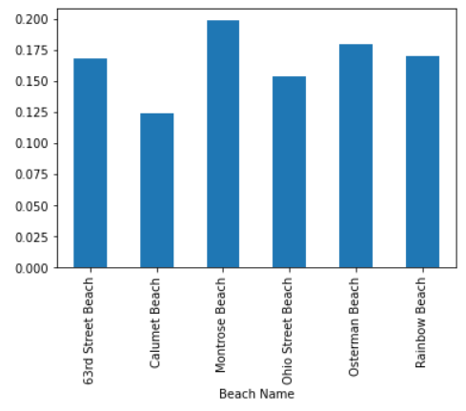
BEACH NAME VS WAVE HEIGHT
Highest wave height is seen in Montrose Beach

Slide 8
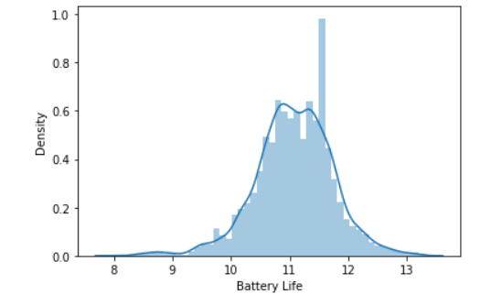
BATTERY LIFE
Battery can last long for 10-12 hours.
Needs replacement after 10 hours for seamless recording

Slide 9
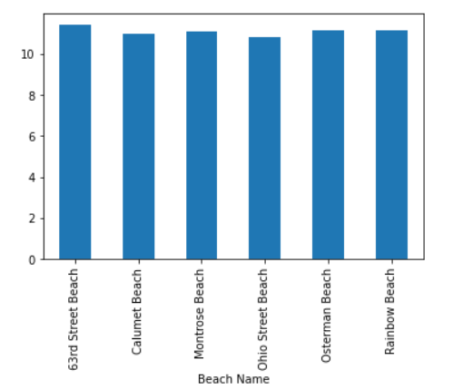
BEACH NAME VS BATTERY LIFE
Almost battery in all beaches have same battery life.

